Slide 1


Headline Verdana Bold
Template v2.1
Audit Online – Release 5.3
Proposed Architecture
Jignesh Patel
Presented on 10/18/2021
WBS: LPX24441-01-01-01-U121
CMDB: CI0010195
Notes:
Updated in v2.1: Image and formatting of slide updated
Please verify that you are using the latest version of the template and ensure you keep the template version number in the top right corner.

Slide 2
Document Control Information
Description | Practice | Name of Standard / Product
Provides the overall architecture blueprint for the application. | Architecture Practice | Proposed Architecture
Version History
Version | Date | Additions/Modifications | Prepared/Revised by
5.0 | 12/1/2020​ | RADC Data Archival Process, Omnia Integration Design, Working Paper Transition | Jignesh Patel
5.1 | 6/24/2021 | Business Value/Release Scope Updates, No architectural changes | Jignesh Patel
5.2 | 7/27/2021 | Business Value/Release Scope Updates, Minor diagram corrections, No architectural changes | Jignesh Patel
5.3 | 10/7/2021 | Business Value/Release Scope Updates, Minor corrections | Jignesh Patel
Approval History
Version | Date | Notes | Approved by/Reviewed by
5.0​ | 3/1/2021​ | Reviewed, one update​ | Janine Kutas-Hille​
5.1 | 7/13/2021 | Reviewed | Janine Kutas-Hille
5.2 | 9/23/2021 | Reviewed | Janine Kutas-Hille
5.3
Notes:
No updates in v2.1

Slide 3
Agenda
Business Summary
Planned Technology Improvements
Usage Statistics/Patterns
Software Quality Attributes
Conceptual System
Secure SDLC
Physical Data Flow*
Architecture Guidelines
Data Classification
DevOps
AI/ML Use*
Team
Infrastructure View
Appendix*
Green Architecture
Notes:
Updated in v2.1: The items with * indicate new sections or pages for the v2.1 template.

Slide 4
Business Summary
Executive Summary
Business Value
Scope
Audit Online is a portal of applications intended to support Audit Transformation. It is comprised of several modules:
RADC Execution Plan
RADC Onsite Portal
RADC ADC Portal
Guided Risk Assessment
Document Extract
EMS Extract/EMS Download
EMS Upload
Omnia Working-paper transition
MI Reporting
DQD Dashboards
·
The main objective of Audit Online V5.3 is to provide an audit transformation solution to address following needs for Global member firms:
Continued DWW Acceleration​
RADC Ramp Up​
Expand RADC Catalog​
Transition to Omnia/Levvia​ Ramp Up
Monitoring Quality & Adoption​
Support and Ongoing Maintenance​
Audit Online V5.3 scope includes
RADC Portal
GRA Enhancements
Technological Enablers
Architecture
Infrastructure
Compliance
Maintenance
Notes:
Executive Summary (Addl Details)
Audit Online is a portal of applications intended to support Audit Transformation. It is comprised of several modules:
· RADC Execution Plan: enables Portfolio Managers to review a catalog of available services for which they can utilize the delivery center. This plan is outside the context of a specific engagement at the higher client level. Based on the results of the Execution Plan, RADC requests are created on the related engagements
· RADC Onsite Portal: A tool that enables the auditor to submit and track service request to a delivery center for assistance on completion of a catalog of services.
· RADC ADC Portal: A web front end (URL) for the RADC users to plan/assign requests within the RADC to various RADC teams, preparers and checkers. A big part of the solution is around planning/scheduling requests, managing delivery center personnel, competencies, tracking and managing planned vs. actual hours spend on each request.
· Guided Risk Assessment: A content-driven tool that suggests risks, controls and procedures based on the auditor's response to tailored questions.
· Document Extract: A tool that enabled the ability for the auditor to extract documents from their EMS file.
· EMS Extract/EMS Download: A tool that allows the auditor to extract documentation from an archived or InProgress EMS file to transfer to another location (I.e. Levvia or Omnia file)
· EMS Upload: A tool that allows the auditor to upload a document to the EMS server without having to deal with EMS synchronization.
· Omnia Workingpaper transition: A tool that facilitates the transfer of engagement worknigpapers from an EMS file to an Omnia engagement file.
· MI Reporting: Standard PowerBI-based reports allowing RADC leaders to monitor operational details of the RADC.
· DQD Dashboards: A web front-end link for Onsite Teams to monitor live engagements and enhanced project management through read-only reports and dashboards.
Updated in v2.1: Minor example update
Executive Summary and Business Value
These are typically provided by the EM and should align with similar definitions within the project charter. This reflects what the business has asked you to produce or solve.
Scope
This reflects what the team has agreed to deliver.

Slide 5
Usage Statistics/Patterns
Category | Information Requested | Response
Targets | Target business / FSS | Audit
 | Who are the users? | Audit Practitioners
Users | Initial # of users (Internal / External) | 20,000 internal users
 | Peak concurrent # of users | 600 users
 | Yearly growth estimate, # of users | 100%
Usage | Usage cycle | Most usage during Audit busy season
 | Is expat usage expected? | No
 | Will this be globally deployed? | Yes
Data Storage | Storage type, technology or platform | OnPrem SQL Server Database, Azure SQL and SQL (Serverless), Azure CosmosDB, Azure Blob Storage
 | Initial data storage space required | 10 GB
 | Yearly growth estimate, data volume | 15 %
Data Retention | Retention period in data storage | Refer to Data Classification slide
 | Purge methodology | Refer to Data Classification slide
Notes:
No updates in v2.1
Concurrent users
For new projects – Assume 10-20% of total users and/or engage Business team for their inputs. AA then makes a logical decision based on other apps usage within FSS / usage pattern
For existing projects – read Omniture data or other system that records usage, if applicable
Data Retention
The business owners of the data are responsible to provide data retention requirements. Such guidance should be provided for the retention and destruction of data in compliance with APR 601 (Records Retention Policies): https://deloittenet.deloitte.com/About/Policies/Admin/Pages/APR-601_Records-Retention-Policies.aspx

Slide 6
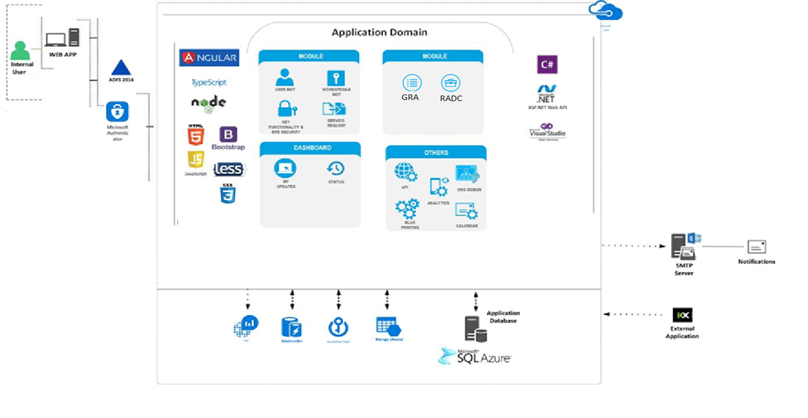
Conceptual System Diagram
Notes:
Updated in v2.1: Minor instructions update
Define Actors – End users and systems that use the solution
UI Technologies – Technologies used in the presentation layer, such as JavaScript libraries and UI frameworks
Domain Model – Conceptual model of the business domain modeled by the application, including key concepts, roles and datatypes.
Cross Cutting Concerns – Technologies used to support key functionality or NFRs across the solution such as storage, configuration, logging, secret management, databases, etc.
Backend Technologies – Server side technologies that are used to host or implement functionality such as APIs, web applications, ETL, background jobs
External Dependencies – External systems that are not part of the solution, but that the solution depends on. Examples may include SMTP, external APIs, Office 365, external data sources such as MDR
PAR Template Diagrams - https://applicationstandards.deloitte.com/app/core/governance/application

Slide 7
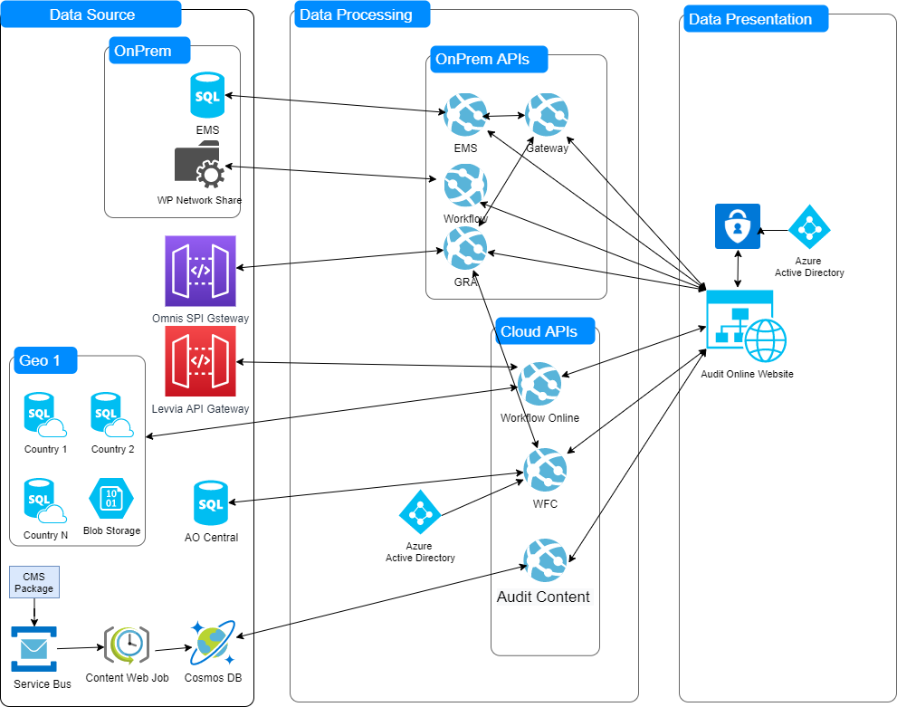
Physical Data Flow
Slide guidance in the Appendix
Notes:
Updated in v2.1: Name of slide and example has been modified. Additional guidance now available in Appendix.
Please use PAR Template Diagram Visio found at - https://applicationstandards.deloitte.com/app/core/governance/application

Slide 8
Data Classification
* Approval date (Data Mgmt CoE): {Date}
Approved by (Data Mgmt CoE): {Name}
Classify all data used or created by the application
Data | Source | Destination | Transfer Method | Retention/Purge Approach | Data Type(s)
Engagement Data | EMS | Application | Application API | Retained with RADC Requests (see RADC Requests Data) | Operational RADC Data Confidential / Sensitive GRA Data
Engagement Data | Levvia | Application | Application API | Retained with RADC Requests (see RADC Requests Data) | Operational RADC Data
Engagement Data | Omnia | Application | Application API | Retained with RADC Requests (see RADC Requests Data) | Operational RADC Data
Engagement Data | Audit Online Projects | Application Database | Application API | If user marks for deletion, data is purged after 30 days Else data is purged after 7 years | Operational RADC Data Confidential / Sensitive GRA Data
RADC Requests Data | Audit Online | Application Database | Application API | Retained for 18 Months | Operational RADC Data
RADC Archival Data | Audit Online | Application Archive Database | Data Factory Pipeline | Retained indefinitely | Archived RADC Data
GRA Data | Audit Online/EMS | Application Database | Application APIs | Retained for 18 months after archive | Confidential / Sensitive GRA Data
Content Data | CMS | Cloud (CosmosDB) | Web Job | Retained indefinitely | Non-sensitive
User Data | Deloitte Active Directory | Application Database | Cloud User API | Retained indefinitely | User PII
Working Paper Documents | Manual/EMS | On Prem File Storage/Cloud Blob Storage | Application API | Retained until engagement is archived or related requests are inactive | Confidential - Deloitte/Client - Sensitive Information
Slide Guidance in the Appendix (3 slides)
* Data Management CoE review of data flow and this slide must be completed before PIA submission
Notes:
Updated in v2.1: The examples have been updated along with note that data flow and data classification must re reviewed by Data Management CoE.
Additional guidance in appendix
Please reference appendix for Data Classification guidance.
Approval required
This slide needs to be reviewed and approved by a member of the Data Management CoE:
DAS Projects: US ITS DAS Data Management CoE <usitsdasdatamanagementcoe@deloitte.com>

Slide 9
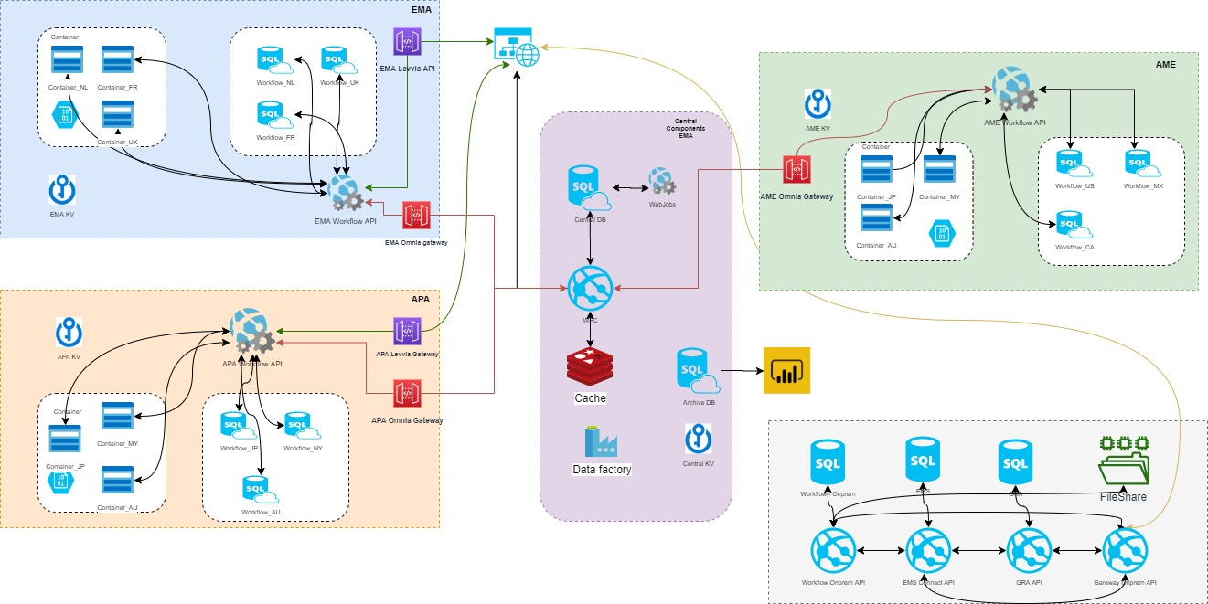
Infrastructure View (Multi-geo)
Notes:
Notes
Include server details for all environments (minimum prod)
Firewall terminating at F5 or Web Server nodes
PAR Template Diagrams
https://applicationstandards.deloitte.com/app/core/governance/application

Slide 10
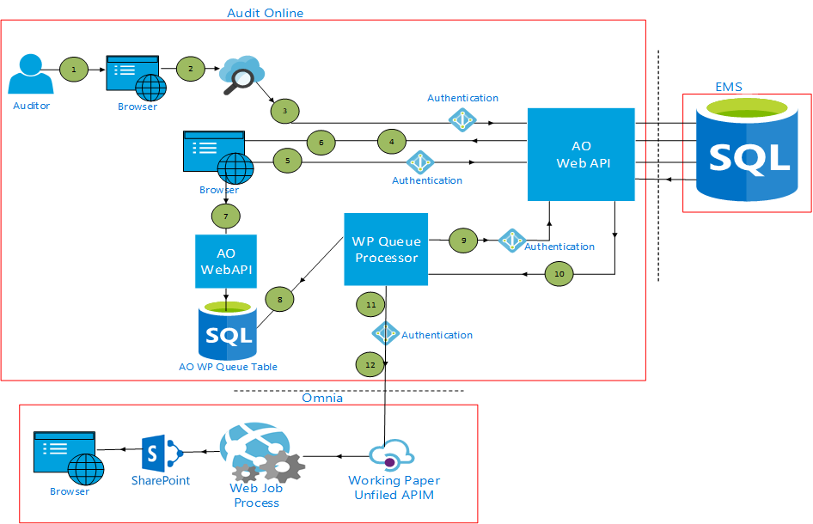
Working Papers Transition (AO/EMS/Omnia)
Steps Description
See Slide Notes
Notes:
Steps Description:
Auditor will open AO Engagement and Working Paper search screen from Omnia application.
Enter an Engagement search criteria and submit engagement search request.
Request will be sent with security headers to AO WebAPI. (Existing API to get EMS engagements)
Get Response for searched engagements and display engagements.
Select Engagement and enter working paper search criteria and submit working paper search request
Get the WebAPI Response for working paper metadata and display it for selected engagement. (Existing API)
Along with Engagement file and selected working papers metadata will be created in some AO staging table using AO WebAPI. (Like upload WPs to EMS)
There will one Omnia working paper queue processor in AO which will pick the pending working papers
Pending working paper blob will be requested using AO WebAPI.(Existing API)
WebAPI will have working paper blob and its metadata as response for further processing
WP Queue Processor will authenticate and Authorize against the Omnia WP API and get the bearer token
WP Queue Processor will call Omnia API endpoints to perform batch processing of working papers by passing required parameters, Working paper blob and bearer token.
WP Omnia Poller fetches status for the transition from Omnia and updates it for corresponding metadata in SQL Table.

Slide 11
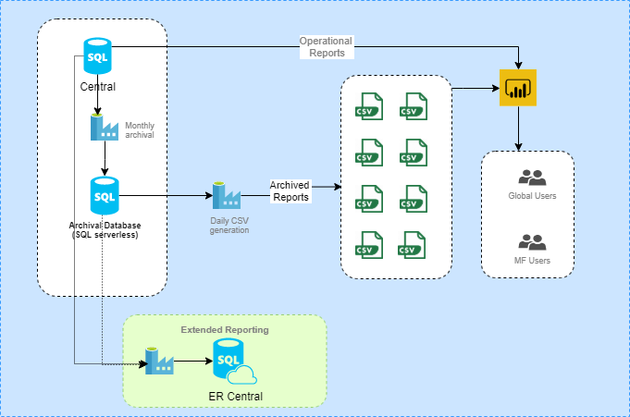
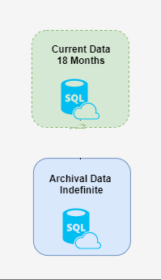
RADC Data Archival
Notes:
Notes
Include server details for all environments (minimum prod)
Firewall terminating at F5 or Web Server nodes
PAR Template Diagrams
https://applicationstandards.deloitte.com/app/core/governance/application

Slide 12
Green Architecture
Legend:
Reusable Component
Consumption of existing component
Reference Architecture
Logging and Instrumentation
Service oriented Architecture
Single Page Application
REST Web Apis
Database Logs
Azure AppInsights for monitoring service status and Application Logs for WFC API Service
Technology / Components / Frameworks
Audit Trails
.NET Core 3.1
.NET Framework 4.6.2
Angular 9.X
Azure Services (App Service, SQL, CosmosDB, Storage, KeyVaults, Service Bus, Redis Cache, Data Factory)
Deloitte.Core Encryption
Deloitte L10N
Deloitte OPM
Database storage of user actions
Notes:
Updated in v2.1: The examples have been updated

Slide 13
Planned Technology Improvements
Category | Technology Focus Area | Current State (tech. debt) | Proposed State {timelines}
Languages and frameworks | Python | 3.8 | Same
 | ASP.Net Core | 3.1 | Same
 | Angular | 9 | Same
 | Twitter Bootstrap | 4 | Same
 | TypeScript | 3.8.4 | Same
Mobile Framework | N/A | <VERSION> | <VERSION>
Notes:
No updates in v2.1
Notes
Entries are examples only. Please feel free to add/edit/delete it.
Remove technologies which are not applicable.
Please work with your Infrastructure / Cloud Architect for the latest / approved version(s) of these technologies.
Technical debt and proposed state must be captured for the finalized list of technologies. If technology is an approved and recent version, leave the proposed state as “Current”.
If the technology is outdated, the proposed date must captured to specify the timeline for upgrading to the recommended version.
For using libraries or new technologies, refer to technologies approved by DAS for use in atlas.deloitte.com
For technologies that affect or need server footprints, reach out to your Infrastructure Architect to ensure that recommended version is used on the current project.
For COTS or platforms hosted or supported by vendor, refer to master licensing agreements to ensure that the current platform is on a supported version. Example: if MLA says that vendor supports version A, A-1, A-2 but the platform is on A-3, the proposed state must indicate the timeline when the platform will be upgraded to a supported version.

Slide 14
Software Quality Attributes
Quality Attributes | Target SLAs
Availability (Refer to Slide #21) | {Level 1: 99.99%; Level 2: 99.9%}
Performance Expectations (Refer to Slide #33)
Mobile | N/A
Web | < 5 Seconds
Reports | N/A
Disaster Recovery / BCP (Refer to Slide #21)
Tier | 2
Recovery Time Objective (RTO) | <24 hours
Recovery Point Objective (RPO) | <24 hours
Recovery Method | Redundant, Replicated (Databases)
Last BCP App / Platform test date(s) | September 2020
Next Compliance due date(s) | September 2021
Unit test / code coverage | > 60 %
Slide Guidance in the Appendix (1 of 3)
Notes:
Updated in v2.1: Unit test should be entered as percentage thus the instruction for this is more explicitly stated.
BCP/DR Procedure site
https://idr.deloitte.com/IDR%20Training/2018%20ITSCM%20Disaster%20Recovery%20Planning%20at%20a%20Glance.pptx

Slide 15
Secure Software Development Lifecycle (SSDLC)
Approval date (Cyber): 10/4/2021
Approved by (Cyber): Lee Kelly
Response values:)
Yes | Not Followed | Not Applicable
Guideline | Response
Cyber Security Requirements On-boarding Questionnaire submitted | Yes
Cyber Security Design Task/Checkpoint completed and accepted | Yes
Privacy Impact Assessment (PIA) completed and approved | Yes
Must Pass Static Code Analysis | Veracode (Score: Pending)
Results from previous release | Previous release score: 100
Must Pass Dynamic Code Analysis, and Penetration test if required | Contrast Score – Pending
Encryption in Transit – e.g., Transport Layer Security (TLS) 1.2 and higher | Yes
Encryption at Rest – Database level encryption | Central DB encrypted natively by Azure; OnPrem DB: N/A
Encryption at Rest – Column/Application-level encryption for high-risk data | Not Applicable
Configuration Protection | Azure App Settings/Azure Key Vault
Total solution meets Segregation of duty control requirements | Yes
Application meets Privileged Access Management (PAM) guidelines | Yes
Hardware Controls, OS and Software meet Cyber guidelines | Yes
Authentication with Multi-Factor Authentication (MFA) | Azure AD with MFA
Slide Guidance in the Appendix
Notes:
Updated in v2.1: Configuration protection is more generically stated rather than assuming .NET with RSA key/Azure Key Vault.
For Cyber, PIA, hardware controls, segregation of duty , encryption and authentication
Please reference this link: https://deloittenet.deloitte.com/sites/MyTechnology/Pages/Security/SSDLC.aspx
Engage DevOps to implement Rivest, Shamir, and Adelman (RSA) encryption/decryption for your application.
For Cyber Security Standards
Please reference this link: https://deloittenet.deloitte.com/sites/mytechnology/pages/security/cyber_security_standards.aspx
For Privileged Access Management (PAM)
It is required to access privileged and elevated accounts through the Privileged Access Management (PAM) solution as standard.
PAM guideline Link: https://wt.deloitteresources.com/solutions/IAM/PAM%20Pages/PAM_Overview.aspx
For more guidance and questions, please contact the PAM Email list: US Password Control System (US) <uspcs@deloitte.com>
Levels of Encryption at Rest
1. System/File/Disk level encryption (most basic level of encryption)
Note that this is turned on by default on the file system for all MS SQL Server DBs in the national data center.
2. Database level encryption (required)
In MS SQL Server this is called TDE (Transparent Data Encryption)
Mandatory for all MS SQL Server DBs (to meet encryption at rest requirement)
3. Column/Application level encryption (required for certain data)
Required for high-risk PII (High-Risk Confidential – Deloitte – Sensitive PI)

Slide 16
Architecture Guidelines
Legend:
Followed
Not Applicable
Not Followed
Error messages will be logged “as is” but the message displayed will be user-friendly.
Use Asynchronous calls for better user experience – as needed.
Application should clearly define data retention requirements and incorporate appropriate data purging processes.
Application will be cross-browser compatible (Edge, Safari for Mac and Chrome).
Application will be multi-platform accessible (laptop, Mac, and iPad).
Application will use Preferred Name instead of Full/Legal Name.
Data will not be integrated from another database without appropriate data owner guidance and approval.
Data will not be duplicated from another database without architecture and data owner approval.
All PII will be encrypted at rest and in transit.
Production Data will not be copied into non-Prod environment without Information Risk and Compliance (IRC) and Product Owner(PPMD) approvals.
Production Data will be Masked using approved tools when a copy is created in non-Production environment.
Mobile applications must have a plan to provide support for both iOS and Android platforms.
Application to provide a mechanism to capture user feedback. Please specify approach used:
Notes:
No updates in v2.1

Slide 17
DevOps
CI/CD
Web Analytics
Monitoring (Alerting/Notification/Support)
Source code repository
Azure DevOps
Build engine
Azure DevOps
Unit testing framework
Xunit
UI Unit testing framework
Jest, Jasmine (with Karma)
Automation Framework
TOSCA, Selenium
Capture Web analytics
Azure AppInsights
Capture Mobile Crash logs
N/A
Support and Notification
Azure Alerts
Logging, Instrumentation and email notifications
Database Logs
AppInsights
Notes:
No updates in v2.1

Slide 18
Team
Role | Names
Architect(s) | Patel, Jignesh <jignpatel@deloitte.com> Bhargav, Anubha <anubbhargava@deloitte.com>
Product Owners | Berkhout, Arnold <aberkhout@deloitte.com> Jackman, Lauren <ljackman@deloitte.com>
Delivery Lead | Hussain, Shabab <shabhussain@deloitte.com>
Deployment team | Ghosh, Anindya <anighosh@deloitte.com> Naveen Chandra, Jaini <jnaveenchandra@deloitte.com> Minik, Vanessa <vminik@deloitte.com>
Platform support teams | #DA Application support <#DAApplicationsupport@DELOITTE.com>
Notes:
No updates in v2.1

Slide 19
Appendix

Slide 20
Systems Availability & Disaster Recovery Standards
Availability Level | Level 1 (High Availability) | Level 2
Overall Targeted Availability | 99.99% | 99.9%
Unscheduled outage tolerance (p/month) | 4.32 minutes | 43.2 minutes
Tier | Core | Tier 1 | Tier 2 | Tier 3 | Tier 4
Recovery Description | Base service required for the support of other applications, communications, restoration of files, etc.. (WAN, LAN, TSM, Exchange, etc.) | Extremely high levels of service availability required to support a critical business process. The operational, financial or reputational risk to the business resulting from a service delivery failure would be high | High levels of service availability required to support an important business process. The operational, financial or reputational risk to the business resulting from a service delivery failure would be high to medium. | The service is important to the business but the operational, financial or reputational risk to the business resulting from a service delivery failure would be medium to low | The service is not mission critical and the operational, financial or reputational risk to the business resulting from a service delivery failure would be low to none
Recovery Point Objective (RPO) | <6 hours | < 6 hours | < 24 hours | < 72 hours | < 72 hours
Recovery Time Objective (RTO) | < 6 hours | < 12 hours | < 24 hours | < 72 hours | < 20 days
Recovery Method | Self healing / Redundant | Self healing / Redundant | Replicated | Restored | Restored
Return to Software Quality Attributes slide
Notes:
No updates in v2.1
T&I Theme: Establish a hosting governance process for all hosted applications
This is Business Continuity Planning / Disaster Recovery
What causes the long turnaround?
The existing process is very prescriptive, does not allow enough flexibility, requires a lot of ITS involvement and has little automation
How are we going to improve the experience?
Eliminate individually scheduled ARB meetings. Introducing twice weekly "office hours" type meetings.
Meetings will happen on Mondays at 2pm CST and Wednesdays at 7AM CST
Each ARB presentation will be given 15 - 20 minutes. Calendar will be managed by ARB team representative
To request time on the schedule, email US ITS Service Resiliency Review distribution group
A reply will be sent with the date and time for presentation.
For more information
https://idr.deloitte.com/IDR%20Training/2018%20ITSCM%20Disaster%20Recovery%20Planning%20at%20a%20Glance.pptx
https://itsm.deloitte.com/SD/SitePages/ITServiceContinuity.aspx
For more guidance and questions, please contact
US BCP Architecture Review Team <USBCPArchReview@deloitte.com>

Slide 21
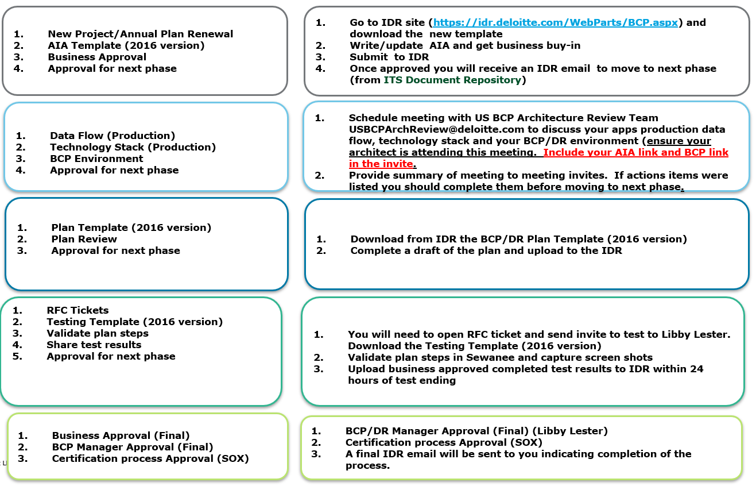
Guidance on Business Continuity Plan (Disaster Recovery)
AIA Phase 1
Sprint 0
ARB Phase 2
Mid Sprint
Plan Phase 3
Test Phase 4
45 days before live
2 weeks before live
APPR Phase 3
Return to Software Quality Attributes slide
Notes:
No updates in v2.1
BCP/DR Sites
https://itsm.deloitte.com/SD/SA/SitePages/DisasterRecoveryDesign.aspx
https://itsm.deloitte.com/SD/SitePages/ITServiceContinuity.aspx
https://idr.deloitte.com/IDR%20Training/IT%20Service%20Continuity%20Management%20Process.Pdf
https://idr.deloitte.com/WebParts/BCP.aspx
BCP/DR Procedure
https://idr.deloitte.com/IDR%20Training/2018%20ITSCM%20Disaster%20Recovery%20Planning%20at%20a%20Glance.pptx
For more guidance and questions, please contact
US BCP Architecture Review Team <USBCPArchReview@deloitte.com>

Slide 22
Disaster Recovery Planning Milestones
AIA
Sprint 0
ARB
After Sprint 0
Plan
Midway Point
Test
45 days before end of project
Approvals
2 weeks prior to close of project
https://idr.deloitte.com/Wiki%20Pages/Home.aspx
Return to Software Quality Attributes slide
Notes:
No updates in v2.1
For more guidance and questions, please contact
US BCP Architecture Review Team <USBCPArchReview@deloitte.com>

Slide 23
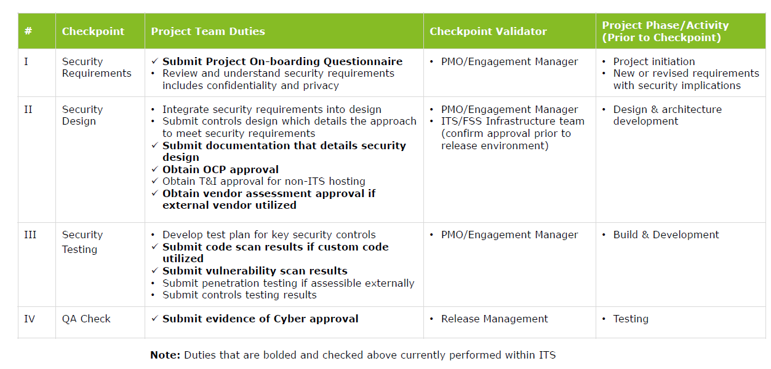
Guidance on Secure SDLC
Sprint 0
Return to SSDLC slide
Notes:
No updates in v2.1
Please refer to Secure SDLC site
https://deloittenet.deloitte.com/sites/MyTechnology/Pages/Security/SSDLC.aspx
https://deloittenet.deloitte.com/sites/MyTechnology/Documents/Security/SSDLC/SSDLC-Cyber-Assessment-Training-Presentation.pdf
Cyber Security Standards link
https://deloittenet.deloitte.com/sites/mytechnology/pages/security/cyber_security_standards.aspx
For more guidance or questions, please contact
US InfoSec Project Review (US) <usinfosecprojectreview@deloitte.com>

Slide 24
Performance Engineering Delivery Process
Standard Responsibilities of DAS PE within Delivery Model
Project onboard
Project evaluation
Stabilization and sign-off
Engage
Planning
Execution
Reporting
Project evaluation with Architecture and Engagement Manager
Ensure performance scenarios are created, reviewed, approved
Performance test scenario execution
Execution of full planned scope on release candidate build (performance scenarios)
Ensure understanding of non-functional requirements
Performance script design
Analysis and benchmarking of results
Documentation of test results
Detailed review of architecture, design and infrastructure
Provide initial task and estimates for duration of effort
Defect, issue logging
Communication of release quality and associated risk
Procurement and alignment
of test data
PE resource, effort and schedule coordination
Document and communicate
testing status
Test completion or exclusion, exception notice published
Single user performance analysis
Support for POCs/NTIs required for project and SLAs definition
Technical RCA
Backlog updated
Solidification of testing models (users, scenarios, environments)
Fine-tuning
PE sign-off
Publish Performance Engineering Plan document
Key milestones
Notes:
Updated in v2.1: New slide

Slide 25
Performance guidelines
Standard delivery model
Performance guidelines describing the response times for various categories of transactions in an application
Types of transactions
1
2
3
Web transactions |  | Backend transactions |  | SAP transactions
Web page Home page load* Mobile transaction | <= 3 sec <= 6 sec <= 1.5 sec | Service call DB call Mobile API Includes SOAP, Rest services | <= 1 sec <= 0.5 sec <= 1 sec | Fiori dashboard RFC call HANA query SAP transaction Includes RFCs, HANA services | <= 6 sec <= 1 sec <= 1 sec <= 2 sec
Project onboard
Project evaluation
Stabilization and Sign-off
Engage
Planning
Execution
Reporting
Guidelines provided are for US locations or users within same GEO as hosting location. Latency will have impact depending on the network parameters of user location.
Performance SLAs for an application are considered from the inputs from approved PAR document.
Guidelines for Data driven transactions can be defined based on the complexity and volume.
*Guidelines for calls involving 3rd party components will be defined based on the architecture direction.
Project evaluation with Architecture and Engagement Manager
Ensure performance scenarios are created, reviewed, approved
Performance test scenario execution
Execution of full planned scope on release candidate build (performance scenarios)
Ensure understanding of non-functional requirements
Performance script design
Analysis and benchmarking of results
Documentation of test results
Reports & File Management
Detailed review of architecture, design and infrastructure
Analysis Office/Excel |  | Reports/Dashboard |  | File upload |  | File download
Web page 1K–50K cells 5K–300K cells 300K–500K cells 500M–1M cells > 1M cells | <= 4 sec <= 8 sec <= 18 sec <= 33 sec <= 52 sec <= 70 sec | SSRS report Tableau/Qlik Fiori reports General Dashboard Executive Dashboard | <= 5 sec <= 8 sec <= 8 sec <= 6 sec <= 5 sec | 0–1 MB 2–10 MB 11–30 MB 31–50 MB 51–100 MB | <= 3 sec <= 9 sec <= 15 sec <= 25 sec <= 35 sec | 0–1 MB 2–10 MB 11–30 MB 31–50 MB 51–100 MB | <= 3 sec <= 6 sec <= 10 sec <= 15 sec <= 20 sec
Provide initial task and estimates for duration of effort
Defect, issue logging
Communication of release quality and associated risk
Procurement and alignment
of test data
PE resource, effort and schedule coordination
Document and communicate
testing status
Test completion or exclusion, exception notice published
Single user performance analysis
Support for POCs/NTIs required for project and SLAs definition
Technical RCA
Backlog updated
Solidification of testing models (users, scenarios, environments)
Fine-tuning
PE Sign-off
Defect severity definition
PE defect severity is decided based on how much a transaction is deviated from the defined SLA
Defect severity
Within SLA
Low
Medium
High
Critical
Publish Performance Engineering Plan document
0
50%
100%
200%
…
Key milestones
Notes:
Updated in v2.1: New slide
For more guidance and questions, please contact
US ITS Deloitte Application Studios Performance Testing India <USITSDASPerformanceTestingIndia@deloitte.com>

Slide 26
Guidance for Physical Data Flow Slide
The Physical Data Flow Diagram provides a visual representation of how Deloitte and/or Client data moves within a system. It uses symbols, as defined below, to show data inputs, outputs, storage points and the routes between each destination. A few notes:
Physical Data Flow vs Logical Data Flow or Workflow: This diagram should show movement of Deloitte data through the system, as opposed to a logical data flow or workflow which focus on business activities and steps. While valuable as well, those belong in the Detailed Architecture Document.
Data from Data Classification should be represented: This diagram should align with and match the data listed in the data classification slide.
Minimum number of diagrams: In some cases, more than one slide/diagram may be needed but a single diagram is preferred, if possible.
Legend: Please be sure to include the legend.
Symbol in the physical data flow | Description
 | Files, databases or repositories that hold data over time. Place the name of the data store (with type of database in parenthesis) between the red lines. Each data store should have at least one data flow in or out.
 | This symbol represents any process that changes the data and results in an output. Examples include ETL, computations, sorting logic, or directing data based upon a ruleset. Describe the process using a short label such as “Submit payment” or “Data Services Job” for example. Some additional tips: Data stored in a system must go through a process. A process should have at least one input and an output. All processes in a DFD go to another process, data store or external entity.
 | This represents another system that sends or receives data and communicates with the described system. These can be both sources or destinations for data entering or leaving the system and can represent an outside organization/person or a technical/business system. They are typically drawn on the edges of the diagram with the name of the external entity in the box.
 | This is the actual route that data takes between an external entity, process or data store. The text on the line always indicates the type, group or description of the data moving in that data movement and should tie back to the data classification slide.
Return to Physical Data Flow slide
Notes:
Updated in v2.1: New slide

Slide 27
Guidance for Data Classification Slide
Note: All data used or created by the application should be classified. “Data” column: Indicate the data domain and the nature of the data. “Retention/Purge Approach” column: Indicate the architected data retention and purge approach, including the aging of data to be purged. Note: The business owners of the data are responsible to provide data retention requirements. Such guidance should be provided for the retention and destruction of data in compliance with APR 601 (Records Retention Policies): https://deloittenet.deloitte.com/About/Policies/Admin/Pages/APR-601_Records-Retention-Policies.aspx Examples: Not retained Refreshed weekly 12 months, purged via automated job Archived in eDRMS after 12 months; manually purged after 7 years 1 year after engagement is closed, purged via automated job Flagged after 1 year then manually purged after administrative review 7 years, purge process TBD Permanent
Return to Data Classification slide
Notes:
No updates in v2.1
For more guidance and questions, please contact
DAS Projects: US ITS DAS Data Management CoE <usitsdasdatamanagementcoe@deloitte.com>
TOM Projects: Stark, Edward (US - Tampa) <estark@deloitte.com>

Slide 28
Guidance for Data Classification Slide (continued)
“Data Classification” column: For each entry on the slide select the appropriate classification from the list below. Public – Deloitte Public – Deloitte – Personally Identifiable Information (PII) Confidential - Deloitte/Client - Personally Identifiable Information (PII) Confidential - Deloitte/Client - Sensitive Information Confidential - Deloitte/Client - Financial Information Confidential - Deloitte/Client - Export Controlled Data and Information Confidential - Deloitte/Client - Controlled Unclassified Information (CUI) Confidential - Deloitte/Client - Other (specify) May be based on contractual terms, regulations High-Risk Confidential - Deloitte/Client - Sensitive PII High-Risk Confidential - Deloitte/Client - Special Handling PII High-Risk Confidential - Deloitte/Client - Protected Health Information (PHI) High-Risk Confidential - Deloitte/Client - Confidential Supervisory Information (CSI) High-Risk Confidential - Deloitte/Client - Other (specify) May be based on contractual terms, regulations
Return to Data Classification slide
Notes:
No updates in v2.1
Definitions
(adapted from the Deloitte US Privacy Policy - 910:
https://deloittenet.deloitte.com/About/Policies/Admin/Pages/910_Privacy_Policy_US.aspx
and the Office of Confidentiality and Privacy site:
https://deloittenet.deloitte.com/About/Confidentiality/Pages/PersonallyIdentifiableInformation.aspx)
Client data: Any data that is generated, produced or is the by-product of engaging, interacting, or performing work for clients or potential clients of Deloitte that is not publicly available.
Deloitte data: Any data other than client data.
Personally identifiable information (PII): Information about an individual that may directly or indirectly identify them. This can be an identification number or factors specific to their physical, physiological, mental, economic, cultural or social identity.
Sensitive PII: PII specifying medical or health conditions, racial or ethnic origin, political opinions, religious or philosophical beliefs, trade union membership, genetic data, biometric data or information specifying the sexual orientation of an individual.
Special handling PII: PII including government identifiers such as social security numbers, driver's license numbers, or state ID numbers; financial account numbers or credit or debit card numbers in combination with any required security code, access code or password to access a person's financial accounts; medical information; biometric data; and health insurance information. Special Handling PII also includes a user name or email address in combination with a password or security question answer that would permit access to an online account.
Protected health information (PHI): PII relating to an individual's past, present, or future physical or mental health or condition; the provision of health care to an individual; or the past, present, or future payment for the provision of health care to an individual.
Sensitive information: Any information that, if subject to unauthorized access or disclosure, could cause financial, reputational harm to Deloitte, individuals or clients (e.g., privileged information).
Financial information: Information about an entity’s finances that is not publicly available.
Export controlled data and information: Export controlled items include any Hardware, Software, Technical Data, Technology, or Defense Services that are subject to item-specific controls in either the ITAR or EAR, including any items, articles or services listed in the (“CCL”) or (“USML”).
https://deloittenet.deloitte.com/About/Policies/Admin/Pages/960ExportControlsCompliance.aspx
Controlled unclassified information (CUI): Controlled Unclassified Information (CUI) is information that requires safeguarding or dissemination controls pursuant to and consistent with applicable law, regulations, and government-wide policies but is not classified under Executive Order 13526 or the Atomic Energy Act, as amended.
https://www.archives.gov/cui/about
Confidential supervisory information (CSI): Exempt information consisting of reports of examination, inspection and visitation, confidential operating and condition reports, and any information derived from, related to, or contained in such reports; (ii) Information gathered by the Board in the course of any investigation, suspicious activity report, cease and-desist orders, civil money penalty enforcement orders, suspension, removal or prohibition orders, or other orders or actions under the Financial Institutions Supervisory Act of 1966, Public Law 89–695, 80 Stat. 1028 (codified as amended in scattered sections of 12 U.S.C.), the Bank Holding Company Act of 1956, 12 U.S.C. 1841 et seq., the Home Owners’ Loan Act, 12 U.S.C. 1461 et seq., the Federal Reserve Act, 12 U.S.C. 221 et seq., the International Banking Act of 1978, Public Law 95–369, 92 Stat. 607 (codified as amended in scattered sections of 12 U.S.C.), and the International Lending Supervision Act of 1983, 12 U.S.C. 3901 et seq.; except— (iii) Any documents prepared by, on behalf of, or for the use of the Board, a Federal Reserve Bank, a federal or state financial institutions supervisory agency, or a bank or bank holding company or other supervised financial institution.
https://www.govinfo.gov/content/pkg/CFR-2013-title12-vol4/pdf/CFR-2013-title12-vol4-sec261-2.pdf
For more guidance and questions, please contact
DAS Projects: US ITS DAS Data Management CoE <usitsdasdatamanagementcoe@deloitte.com>
TOM Projects: Stark, Edward (US - Tampa) <estark@deloitte.com>

Slide 29
Global Data Classification Standards
Illustrative Data Examples by Data Classification:
Data Classification
Public (Risk: Low) | Confidential (Risk: Medium) | High Risk Confidential (Risk: High)
Indefinite set of examples. See definition. | Methodologies Deliverables Information on products, services and pricing Software that may be protected using trade secrets, trademarks, copyright, and patents Policies, standards, procedures (e.g., firewall rules, infrastructure manuals) E-learning content Account numbers, addresses, dates of birth, personnel numbers Photograph or video footage of individuals Financial or salary data Business plans Data relating to the initial public offerings (IPO), Mergers & Acquisitions (M&A), restructuring or bankruptcy Usage rates, sales pipeline, marketing data Forensic investigation data Fraud investigation data | Data on medical or health conditions, racial or ethnic origin, political opinions, religious or philosophical beliefs, trade union membership, sexual preferences, offenses or criminal convictions Government identifiers, financial account numbers, and passwords or personal identification numbers for financial accounts
Data Encryption Guidance by Data Classification:
Data Classification | Encrypted In-Transit (e.g. TLS 1.2 or SFTP/SSH) | Encrypted At Rest (System / File / Disk Level)* | Encrypted At Rest (DB Level e.g. TDE) | Encrypted At Rest (DB Column / Application Level)
Public | Not Required | Not Required | Not Required | Not Required
Confidential | Required | Not Required | Required** | Elective
High Risk Confidential | Required | Elective | Required | Required
* - Note that this is turned on by default on the file system for all MS SQL Server DBs in the national data center.
** - Elective per Global standards, but Required per US standards.
Return to Data Classification slide
Notes:
Updated in v2.1: Minor formatting updates
For more guidance and questions, please contact
DAS Projects: US ITS DAS Data Management CoE <usitsdasdatamanagementcoe@deloitte.com>
TOM Projects: Stark, Edward (US - Tampa) <estark@deloitte.com>

Slide 30
AI/ML - Data Collection
Q: Did you use appropriate training/testing procedures to ensure model accuracy? How do you measuring the accuracy of your model?
“Training and Testing Procedures”: We train AI/ML models on a limited sample data, as a result model bias arises. This can be due to the way data is collected, or just due to issues in random data sampling. It becomes very important to apply the correct training/testing procedure to minimize bias arising from sample data. Examples: Cross Validation – Hold Out Cross Validation – K-Fold Cross Validation – Stratified K-Fold Leave One Out Cross Validation (LOOCV) “Metrics to Measure Model Accuracy”: The performance of your Model on the testing dataset can be measured using various metrics, which depend on the outcome you’re trying to model. Please ensure you are measuring the performance by using the appropriate metric. Examples: Classification Accuracy Logarithmic Loss Confusion Matrix Area under Curve Please click here for details on above procedures.
F1 Score
Mean Absolute Error
Mean Squared Error
Return to AI/ML slide
Notes:
Updated in v2.1: New slide

Slide 31
AI/ML Risk Assessment
Q: Is the ML model resilient to abnormal behaviors and model attacks?
The system should be able to identify abnormal behaviors and prevent manipulation or coercion outside of normal boundaries of acceptable behavior in relation to the AI system and the specific task.
Examples of Intentionally Motivated Attacks: Please click here for the complete list
Perturbation Attack (Modify query to get appropriate response)
Poisoning Attack (Contaminate training phase of ML systems to get intended result
Backdoor ML (Backdoors algorithm to activate with a specific trigger)
Examples of Intentionally Motivated Attacks: Please click here for the complete list
Reward Hacking (Reinforcement Learning (RL) systems act in unintended ways because of mismatch between stated reward and true reward)
Incomplete Testing (The ML system is not tested in the realistic conditions that it is meant to operate in)
Return to AI/ML slide
Notes:
Updated in v2.1: New slide

Slide 32
AI/ML Risk Assessment
Q: Do you have auditing/event-tracing facilities at the algorithm level to examine inaccurate decisions or prove correctness and transparency of AI generated decisions?
Having the ability to identify the data points and algorithm metadata leading to specific results will be of great benefit especially in high-value decision making. Additionally, capabilities such as ‘tamper detection’ will assist in detecting and responding to intentional attacks.
Examples:
The timeframe in which the last training event occurred
The timestamp of the most recent dataset entry trained upon
Weights and confidence levels of key classifiers used to arrive at high-impact decisions
The classifiers or components involved in the decision
The final high-value decision reached by the algorithm
Return to AI/ML slide
Notes:
Updated in v2.1: New slide

Slide 33
AI/ML Risk Assessment : Intentionally Motivated Failures
Q: Is the ML model resilient to abnormal behaviors and model attacks?
The system should be able to identify abnormal behaviors and prevent manipulation or coercion outside of normal boundaries of acceptable behavior in relation to the AI system and the specific task.
No. | Attack | Overview | Violates traditional authorization?
1 | Perturbation attack | Attacker modifies the query to get appropriate response | No
2 | Poisoning attack | Attacker contaminates the training phase of ML systems to get intended result | No
3 | Model Inversion | Attacker recovers the secret features used in the model by through careful queries | No
4 | Membership Inference | Attacker can infer if a given data record was part of the model’s training dataset or not | No
5 | Model Stealing | Attacker is able to recover the model through carefully-crafted queries | No
6 | Reprogramming ML system | Repurpose the ML system to perform an activity it was not programmed for | No
7 | Adversarial Example in Physical Domain | Attacker brings adversarial examples into physical domain to subvertML system e.g: 3d printing special eyewear to fool facial recognition system | No
8 | Malicious ML provider recovering training data | Malicious ML provider can query the model used by customer and recover customer’s training data | Yes
9 | Attacking the ML supply chain | Attacker compromises the ML models as it is being downloaded for use | Yes
10 | Backdoor ML | Malicious ML provider backdoors algorithm to activate with a specific trigger | Yes
11 | Exploit Software Dependencies | Attacker uses traditional software exploits like buffer overflow to confuse/control ML systems | Yes
Return to AI/ML slide
Notes:
Updated in v2.1: New slide

Slide 34
AI/ML Risk Assessment : Unintentional Failures
No. | Attack | Overview
1 | Reward Hacking | Reinforcement Learning (RL) systems act in unintended ways because of mismatch between stated reward and true reward
2 | Side Effects | RL system disrupts the environment as it tries to attain its goal
3 | Distributional shifts | The system is tested in one kind of environment, but is unable to adapt to changes in other kinds of environment
4 | Natural Adversarial Examples | Without attacker perturbations, the ML system fails owing to hard negative mining
5 | Common Corruption | The system is not able to handle common corruptions and perturbations such as tilting, zooming, or noisy images.
6 | Incomplete Testing | The ML system is not tested in the realistic conditions that it is meant to operate in.
Return to AI/ML slide
Notes:
Updated in v2.1: New slide

Slide 35
Guidance for AI/ML - Data Collection
“Training and Testing Procedures”: We train AI/ML models on a limited sample data, as a result model bias arises. This can be due to the way data is collected, or just due to issues in random data sampling. It becomes very important to apply the correct training/testing procedure to minimize bias arising from sample data. Examples: Large Data Sets ( >): Cross Validation – Hold Out Cross Validation – K-Fold Cross Validation – Stratified K-Fold Other Small Data Sets (<): Leave One Out Cross Validation (LOOCV) “Metrics to Measure Model Accuracy”: The performance of your Model on the testing dataset can be measured using various metrics, which depend on the outcome you’re trying to model. Please ensure you are measuring the performance by using the appropriate metric. Examples: Classification Accuracy Logarithmic Loss Confusion Matrix Area under Curve F1 Score Mean Absolute Error Mean Squared Error
Return to AI/ML slide
Notes:
Updated in v2.1: New slide

Slide 36
AI/ML Use*
SAMPLE
AI/ML Type | AI – Computer Vision – Facial Recognition | ML Algorithm | Azure Face API | Vendor | Azure
Category | Information Requested | Response
Data Collection | Did you use appropriate training/testing procedures to ensure model accuracy? How do you measure the accuracy of your model? | Yes Decision depends on confidence score from Face API
 | Is the ML model resilient to abnormal behaviors and model attacks? ( For e.g., adding noise to training dataset) | Yes, tested the model with noise
Risk Assessment & Ethical AI | Is the data anonymized? Is there a legal need for data anonymization? | No, data is not anonymized. User consent (Opt in and out) is captured per OGC guidelines
 | Did you ensure your data is not biased? What are you doing to reduce bias? | Depend on Face API, however human is in the middle
 | Do you have built-in forensics and security logging in place to provide transparency and accountability? | Yes, both custom & OOTB logging
 | Are end-users and stakeholders explicitly notified about the AI nature of the application/system? How are you explaining the use of AI/ML to users/stakeholders? | Obtain User consent (Opt in and out)
 | Is the model output intended for enhancing direct human experience, or affect a personnel in any form which identifies the personnel’s classification into group(s) or category based on their traits/attributes/demography?​ | N/A
 | Does the model produce recommendation of any strategic/financial decision making?​ | N/A
 | Does the model make decisions related to any existing law, rules and regulations?​ | N/A
 | Do you have Personnel(s)/automated process validating the model output and continuously monitoring?​ | Yes, application team & business stakeholders
AI Deployment | Have you implemented AI / ML Ops (Ex. identifying model drift, user feedback loop and model re-training)? | Yes
 | Do you have feedback mechanism established for users/stakeholders? | Yes
Return to AI/ML slide
Notes:
Updated in v2.1: New slide
AI/ML Type
AI – Cognitive Services – Speech API
AI – Cognitive Services – NLP/NLG
AI – Cognitive Services – Text Analytics
AI – Cognitive Services – Decision APIs
AI – Cognitive Services – Sech API
AI – Cognitive Services – Other – Name it
AI – Computer Vision – OCR
AI – Computer Vision – Facial Recognition
ML Algorithm / Services used (applicable for Vendor products)
Supervised – Classification
Supervised – Regression
Supervised – Other – Name it
UnSupervised – Clustering
UnSupervised – Association
Other – Name it
Azure Face API
AWS Translate etc
Vendor
Microsoft
Amazon
Google
Include guidance on the following:
Do each ML model have a documented approach on model explainability? Is this tracked as a low-level design topic? (business context, selected technique and approach, rationale for taking this approach and approach limitations) – guidance
Can you revert to an earlier version of the model?
Output explainability in the form of story telling
What percentage of data will be used for training and validation? (include guidelines differentiating High risk vs. Low Risk)
Is the ML model resilient to abnormal behaviors and model attacks? (Provide guidance on abnormal behaviors with examples)
Is the data anonymized? Is there a legal need for data anonymization? (Guidance on what kind of data should be anonymized)
Did you ensure your data is not biased? (include guidance on types data biases to look out for)

Slide 37
Guidance to Enterprise Architect (EA) on PAR Review
There are 3 types of PAR Reviews: Full / Delta / Expedited
Full PAR Review
Delta PAR Review
Expedited
New project or existing application with significant architectural changes.
All PAR slides to be reviewed.
Need to follow DAS PAR Approval workflow
Delta architectural changes will be made to an existing application.
All slides to be updated as in a full PAR & Detailed Architecture Document.
The Delta PAR presentation will focus on the summary slide and diagrams to illustrate – only reference other sides if asked.
No architectural changes will occur during this project, so this PAR is not presented during the PAR call
The Expedited PAR is instead submitted to Architecture CoP for offline review and approval.
No further PAR changes should be required except the Cover, Business Summary, Cyber signoff and Team slides. Other minor items may be modified but need to be indicated to reviewers.
Notes:
Updated in v2.1: Added Cyber signoff as required by expedited PAR
For more guidance and questions, please contact
US ITS DAS Pre-PAR Board Group <usitsdaspreparboardgroup@deloitte.com>

Slide 38
Expedited PAR Request Template – Guidance to Enterprise Architect
To submit the Expedited PAR Request, EA should send the PAR deck plus the Detailed Architecture Document:
To:
Praveen Pemmaraju ppemmaraju@deloitte.com
and CC:
Appropriate SA/EA
US ITS DAS Pre-PAR Board Group usitsdaspreparboardgroup@deloitte.com
Subject: Expedited PAR Approval Request for <project name>
Body:
Reasons for Expedited PAR
Last PAR approval date
Planned Release date
Number of sprints
Name of the Channel
Attach PAR and Detailed Architecture Document
Budget
Notes:
No updates in v2.1
For more guidance and questions, please contact
US ITS DAS Pre-PAR Board Group <usitsdaspreparboardgroup@deloitte.com>

Slide 39
Proposed Architecture Review (PAR) Process Flow
Legend:
Parallel flow:
Sequential flow:
Responsible
Deloitte Application Studios
Accountable
Engagement Manager
(or) TDM
Business
Solutions Analyst
Performance
Engineering Team
Infrastructure (or)
Cloud Architect
Application Architect
BCP/DR
Team
Data Management CoE & AI CoI
Cyber Security
&
PIA Team
Enterprise Architect
(Level 1 Review)
Pre-PAR Board (Level 2 Review)
Architecture Practice
Board
(Final Review)
Data Flow & Data Dictionary
(PARSlide#8)
Create
NTI / TAE
Upload PAR, DAD, (NTI & TAE)
documents to ATLAS and schedule for reviews in Atlas* site.
ARB Sign-off
(PAR Slide#16, 22-24)
(Optional in Sprint 0)
Data Flow & Classification Review & Sign-off (PAR Slide#8, 9 & 26-29)
PIA and Secure SDLC Review & Sign-off (PAR Slide#17, 24, 28 & 29)
PAR
Verification
Architectural
Changes?
Start
Yes
No
Verify all slides of PAR
(PARSlide#42)
Pre-PAR review
Final PAR Practice Board Review
Is NTI / TAE
Required?
Yes
Onboard Project & Register in CMDB if it is new project
(PARSlide#1)
User Story & Estimation
AI/ML component?
No
No
Full
Full / Delta
Review?
(PARSlide#38)
Yes
AI CoI Review & Sign-off (PAR Slide#10 & 30-37)
Delta
Send an email to Practice Lead & Pre-PAR Board for expedited approval
(PARSlide#39)
Create Project Charter, SOW
& AIA
(PARSlide#4)
Scope Modeling
(PARSlide#4)
Evaluate
Technology Debt
(PARSlide#14, 15)
Create Proposed Architecture
Document (PAR)
Verify delta slides of PAR
(PARSlide#30)
Create Detailed
Architecture
Document
(DAD)
No
Create Cyber Assessment
Questionnaire
(PARSlide#17)
Requirements
Elicitation
(PARSlide#4)
Create Performance
Test Plan
Yes
Expedited
Request
Approve / RFI?
No
Requires Firm Systems Integrations?
Approve
Yes
Request for more info
Create
Privacy Impact Assessment
(PARSlide#17)
Stakeholder need
Analysis
(PARSlide#4,5)
Gather Software Quality
Requirements
(PARSlide#16)
Infrastructure View
(PARSlide#11 & #12)
Is it a COTS Product?
End
Notes:
Updated in v2.1: Added the AI/ML review and modified the order of when the PIA must be approved.
Roles & Responsibilities in PAR Process
Engagement Manager & BSA are accountable for completing the PAR Process.
Application Architect is the responsible for completing the PAR Process.
Rest of the stakeholders are consulted for completing the PAR Process.
COTS Stands for “Commercial Off-the-Shelf” products.
Firm System(s) examples are MDR, Swift, HANA, SAP ECC & AD.
Site for New Tech. Introduction (NTI) & Technology Approach Evaluation (TAE) Templates & Procedures
https://applicationstandards.deloitte.com/app/core/governance/technology
Pre-PAR Board distribution list
US ITS DAS Pre-PAR Board Group <usitsdaspreparboardgroup@deloitte.com>
PAR Scheduling site
https://atlas.deloitte.com
Data Management CoE distribution list
US ITS DAS Data Management CoE <usitsdasdatamanagementcoe@deloitte.com>
AI CoI distribution List
US ITS DAS AI COI <usitsdasaicoi@deloitte.com>
BCP / DR Team distribution list
US BCP Architecture Review Team <USBCPArchReview@deloitte.com>
Cyber Security distribution list
US InfoSec Project Review (US) <usinfosecprojectreview@deloitte.com>
Technology Risk Privacy Impact Assessment (PIA) Team in US Confidentiality & Privacy
US Confidentiality & Privacy <usconfidentialityandprivacy@deloitte.com>
https://resources.deloitte.com/sites/US/About/Confidentiality/Pages/home.aspx
Performance Engineering distribution list
US ITS Deloitte Application Studios Performance Testing India <USITSDASPerformanceTestingIndia@deloitte.com>

Slide 40
About Deloitte Deloitte refers to one or more of Deloitte Touche Tohmatsu Limited, a UK private company limited by guarantee (“DTTL”), its network of member firms, and their related entities. DTTL and each of its member firms are legally separate and independent entities. DTTL (also referred to as “Deloitte Global”) does not provide services to clients. Please see www.deloitte.com/about for a detailed description of DTTL and its member firms. Please see www.deloitte.com/us/about for a detailed description of the legal structure of Deloitte LLP and its subsidiaries. Certain services may not be available to attest clients under the rules and regulations of public accounting. Copyright © 2021 Deloitte Development LLC. All rights reserved. Member of Deloitte Touche Tohmatsu Limited

